Slide 1
Anatomical Comparison of Species of Dirca
Zachary J. Hudson
EEB698 Final Presentation

Slide 2
Introduction
What’s your question?
Does the bark anatomy of species of Dirca differ?
Why is this important/interesting?
Dirca palustris 1753
Dirca occidentalis 1878
Dirca mexicana 1995
Dirca decipiens 2009
Anatomical studies involving the family and genus only use D. palustris as a representation. Only wood anatomy has been investigated for D. occidentalis. No anatomical investigation for D. mexicana or D. decipiens.

Slide 3
Why is this important/interesting?
Historical documentation lists of the bark of Dirca sp. as used by Native America peoples to create cordage.
Artifacts which have been identified to contain bark from Dirca have not been identified to species.
If anatomical differences are identified, artifacts could potentially be identified to species.

Slide 4
What are Dirca?
First documented use in 1697 by Michel Sarrazin, surgeon to King Louis XIV (Mottiar, 2012)
Dirca palustris bark (circled), Baby Cradle M3-47, Montgomery Shelter 3. Ozark Bluff Dwellers (Dellinger, 1936)

Slide 5
Remedy Anatomical Discrepancies
Tieghem, 1896
Holm, 1921
Choquette, 1925
Phloem Tissue
Xylem Tissue

Slide 6
Methods (1 slide)
How did you test your question? (focus just on the part you are analyzing for this class)
Cell characteristics of bark tissue of all four species of Dirca measured from stained micrographs. Four replicate measurements were made for each cell type, per three independent plants, per population, per species. Populations collected: D. palustris (ME, FL, & ND), D. occidentalis (CA), D. mexicana (IA & RI), D. decipiens (KS, AR)

Slide 7
Be sure to clearly convey how you measured your response (what did you count/measure/observe?) and your predictors and covariates
Cell types investigated include bark fiber, sieve tube member, phloem parenchyma, companion cells, and ray cells.
Linear measurements and quantity were taken or each cell type. Variables measured include primary wall thickness, secondary wall thickness, length, lumen diameter, cell total diameter, number of cell width (ray width), and seriate number, when applicable

Slide 8
Analysis (~3 slides)
What was your approach? What type of model did you fit?
Tidy Database
Species
Population
Cell Type
Response Variable
Subsetted by cell type
Histograms to check for normality

Slide 9
What was your approach? What type of model did you fit?
Originally thought I was going to perform a MANOVA, used RRPP package.
Decided my model was univariate non-linear so ANOVA was correct but could still use RRPP

Slide 10
How did you assess significance/importance of predictors?
Permutational univariate ANOVA (1-way perANOVA) with pairwise comparison for each variable measured for each cell type
Not concerned with interaction of species x population because I am surveying.

Slide 11
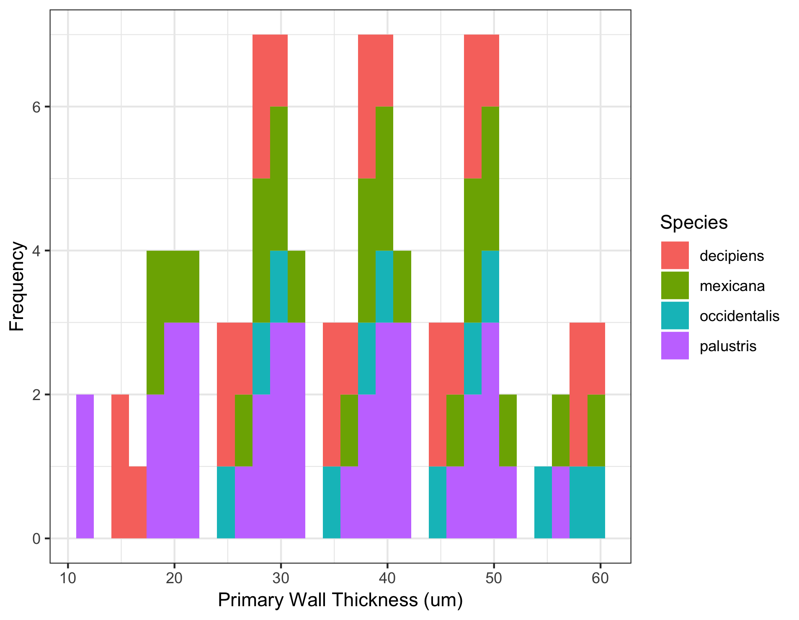
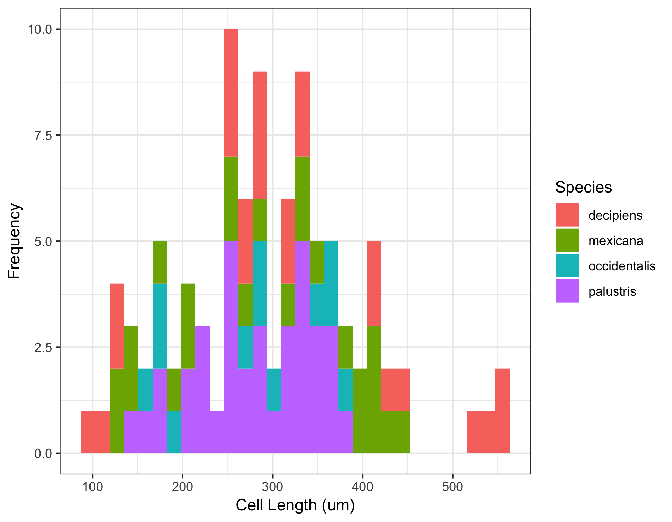
Results (1-2 slides)
What did you find? Show us the graph that best displays your results.

Slide 12
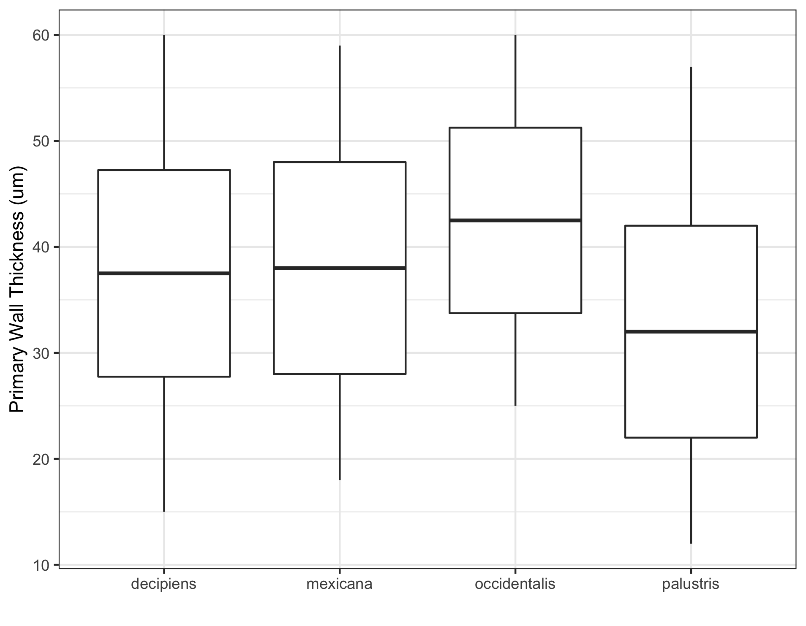
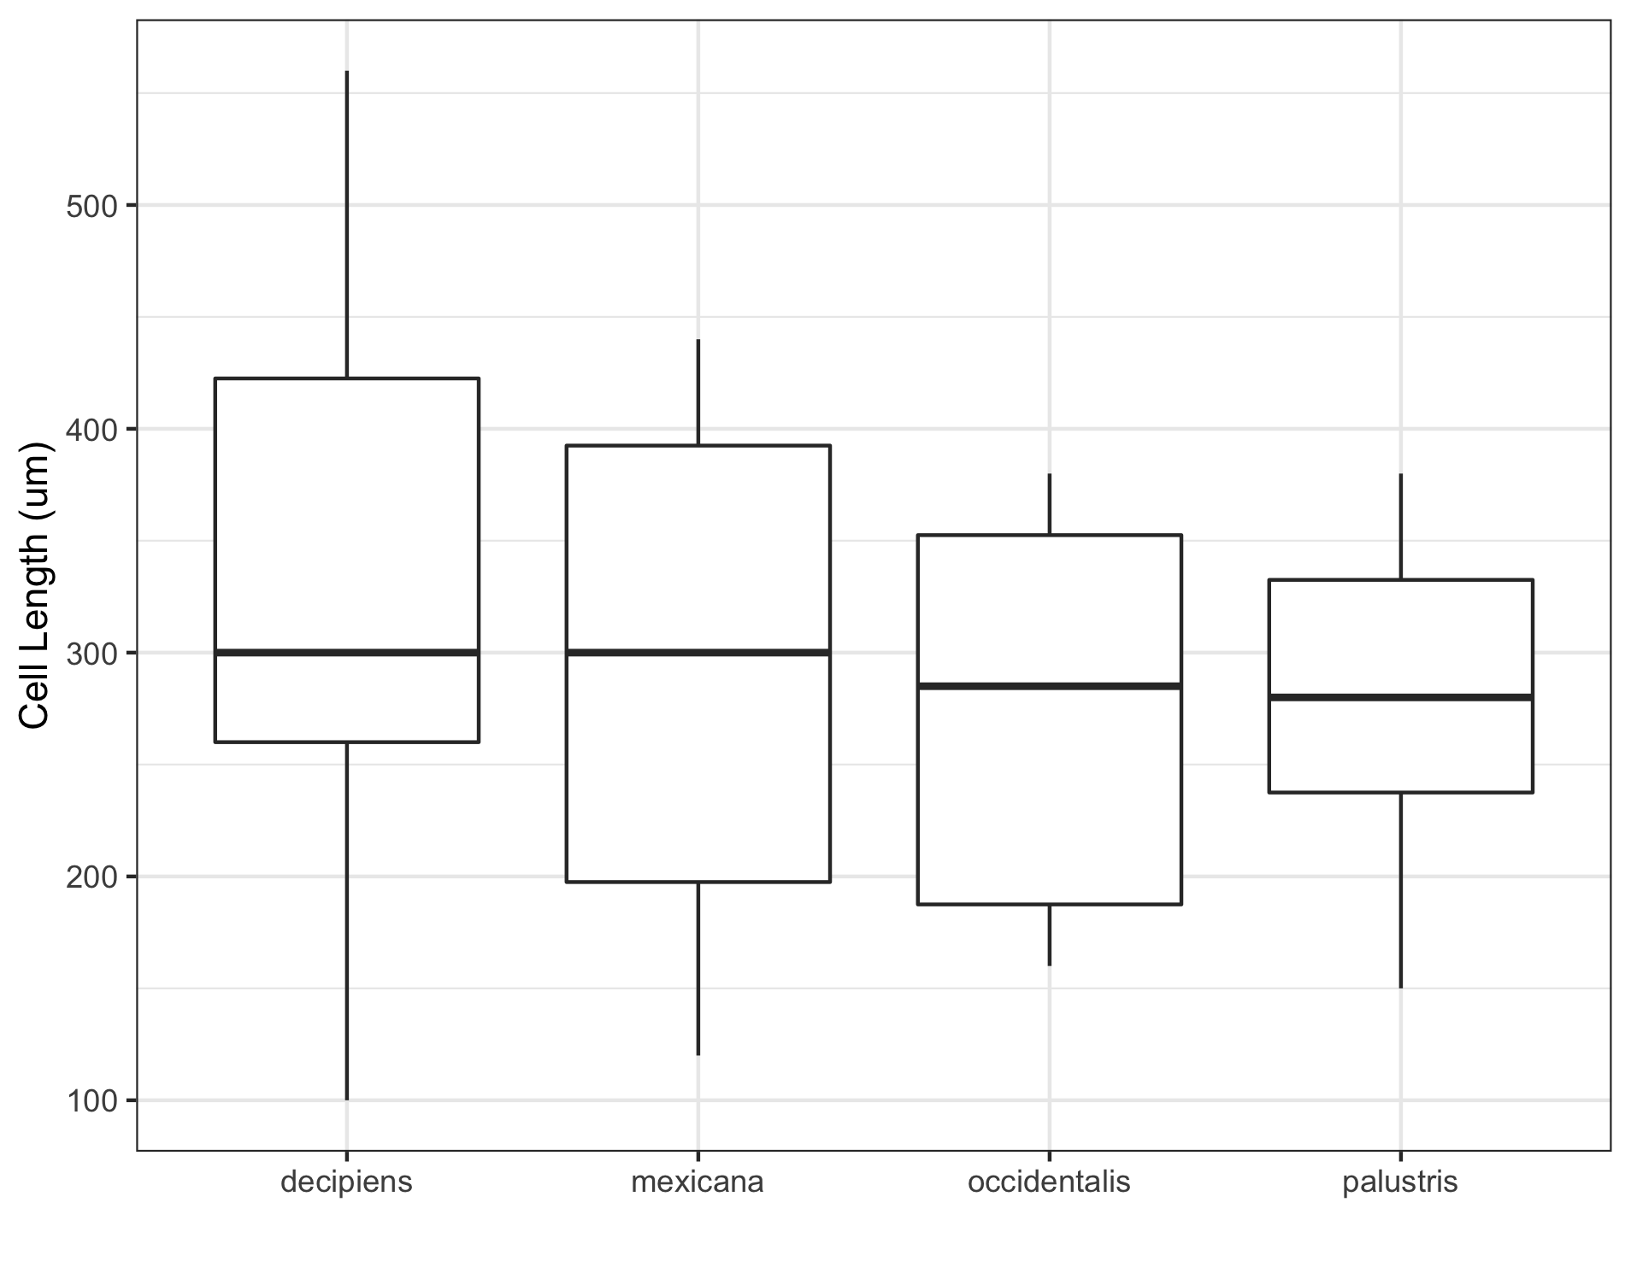
Results
ANOVA p = 0.215
occidentalis:palustris p = 0.0370
ANOVA p = 0.348

Slide 13
Discussion (1 slide)
What does this mean? Interpret your results in light of your original question/hypothesis
Hypothesis: The bark anatomy of species of Dirca do not differ. Half supported, some characters do and some don’t.
Characteristics could be used to identify archeological artifacts to species.
For all bark fiber characteristics pairwise found occidentalis:palustris differ with primary and secondary wall. Archeological remains would be mainly fibers so would need to rely on other cell types.

